Slide 1
Building the Architectural Bridge
for AbbVie's R&D Convergence Hub
A strategic roadmap to transform disparate data into a unified Semantic Layer powering nallucination-free AI and intuitive user experiences.

Slide 2
The Mandate for a Unified Connective Tissue in Drug Discovery
The Goal
Act as the architectural bridge between AbbVie's vast R&D data and Al-driven insights.
The Output
Transform the AbbVie R&D Convergence Hub(ARCH) into a robust Semantic Layer.
The Method
Apply Model-Based Systems Engineering (MBSE} principles.
The Impact
Power hallucination-free AI and intuitive user experiences for scientists, practitioners, and patients over a precise 24-month execution timeline.

Slide 3


A Four-Layer Blueprint for Actionable R&D Intelligence
Layer 4: Patient & Practitioner-Centric UX Layer
Delivers tailored experiences at the exact point of consumption.
Layer 3: AI & Prompt Engineering Layer Employs RAG to guarantee grounded, hallucination-free outputs.
Layer 2: Semantic Harmonization Layer Translates disparate strings into unified biological things.
Layer1: Data Ingestion & Content Repositories Centralizes over 200 distinct sources and legacy systems.

Slide 4



Layer1Centralizes over 200 Distinct Data Sources
and Legacy Systems
AbbVie Proprietary Data:
Internal clinical trial data and Real-World Data (RWD).
External Integration: Seamless connection with massive legacy systems.
The Tellic Advantage: 1B+ biomedical relationships from literature, patents, and trials.

Slide 5

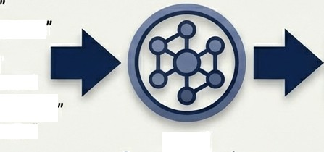

Layer 2 Harmonizes Disparate Strings into Universal Biological Things
”Tumor
”Neoplasm
"Tumor"
"Neoplasm"
"C0027651"
^{"Tumor”‹•}NeopIasm
“C0027651"
Neo4j Semantic Engine
The Engine: A Neo4j graph database serves as the core of the ARCH platform for semantic harmonization.
Universal Recognition: Ensures a gene or disease is recognized universally across the enterprise regardless of source formatting.
Compliance & Integrity: Applies controlled vocabularies and
ontologies via SciBite to maintain rigorous data integrity.

Slide 6

Layer 3 Employs RAG to Guarantee Hallucination-Free AI Insights
Enterprise Prompt Library
User Question | AWS —+ Bedrock Router | Precise Cypher Query | . | Neo4j Semantic Graph | • | Absolute Ground Truth |  | Verified Answer
 |  |  |  |  |  |  | “
Enterprise LLM Router: Utilizes AWS Bedrock to process user interactions.
Retrieval-Augmented Generation (RAG): The LLM interacts directly with the Neo4j graph.
Context Engineering: An enterprise prompt library ensures the LLM retrieves exact Cypher query outputs.
The Result: Answers are strictly grounded in factual data, entirely mitigating the risk of hallucinations.

Slide 7




Layer 4 Delivers Tailored User Experiences Across the Ecosystem
^ Rare Hopes UX
"
Ask ARCH
Scientists
‘Ask ARCH' provides a natural language interface alongside visually intuitive Target and Safety Dossiers, eliminating the need to understand complex database structures.
Practitioners
Modernized interfaces like the AbbVie Science Oncology plaiform deliver tailored research updates directly to Healthcare Professionals.
Patients
The Rare Hopes UX translates complex graph hypotheses into accessible, actionable insights for rare disease patients and their doctors.

Slide 8
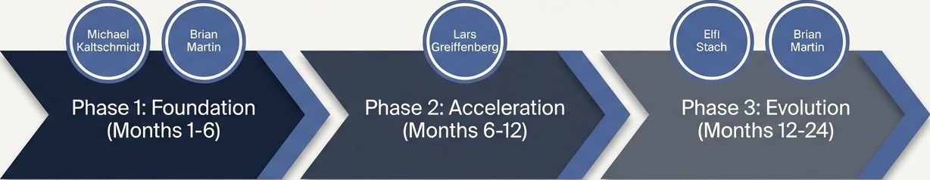
A 24-Month Execution Roadmap Built Around
Core Leadership Mandates
Establish Semantic Ground Truth
Focus on integration, zero data loss, and
foundational AI grounding.
R&D Acceleration & Product-Market Fit
Focus on research tools, dossier rollouts, and patient digital twins.
Articulation, UX, and Transition to LAMs
Focus on ecosystem adoption and autonomous workflows.

Slide 9


Phase1 Solidifies Integration and Establishes Semantic Ground Truth
MBSE Principles
Tellic Knowledge Graph
AbbVie Legacy Systems
Focus: Integration, Data Governance, and AI Grounding.
Solidifying ARCH: Fully integrate Tellic's medical knowledge graph with AbbVie's legacy systems.
MBSE Alignment: Apply Model-Based Systems Engineering principles to guarantee zero data loss during ingestion.
Building the Guardrails: Implement initial RAG frameworks connecting the Neo4j graph to AbbVie‘s LLMs to establish absolute AI ground truth.

Slide 10

Enforcing Data Quality and GxP Readiness for Future Validation
Strict Service Level Agreements (SLAs):
Establish unyielding SLAs for data quality across the platform.
FAIR Principles:
Ensure all ingested and harmonized data meets Findability, Accessibility, Interoperability, and Reusability standards.
Regulatory Foresight:
Engineer the semantic layer to be fundamentally GxP-ready, proactively supporting all future regulatory validation requirements.

Slide 11

Phase 2 Drives R&D Acceleration and Scientific Product-Market Fit
La s
G eiffenberg
Months 6-12
Focus: Value Creation for Scientists and Translational Research.
The Research Accelerator: Transition the ontology from a backend database into a tangible, high-value product.
Strategic Partnerships: Roll out tailored, visually consistent UI tools developed alongside partners like TXI Digital.
Deploying Ask ARCH: Release conversational graph querying to the broader scientific community using advanced prompt engineering.
Target Dossier
Safety Dossier
”

Slide 12
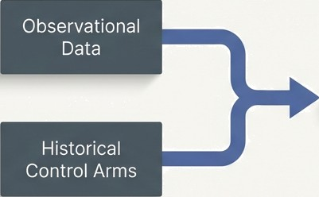



Deploying Patient Digital Twins to Optimize Trial Design
Digital Twin
Prognostic Modeling
Train models on vast arrays of observational data and historical control arms stored in the ARCH graph.
Simulating Placebos
Empower scientists to accurately simulate placebo outcomes for specific patient profiles.
Trial Optimization
Direct impact on reducing redundant experiments and optimizing clinical trial sample sizes, dramatically accelerating time-to-market.

Slide 13
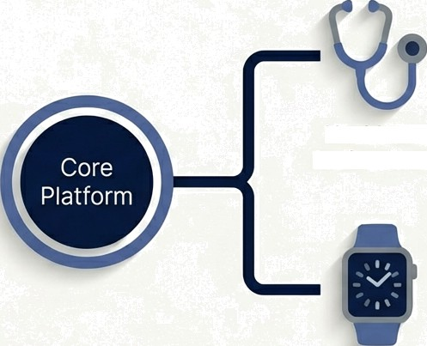
Phase 3 Scales User Adoption
and Integrates Real-World Endpoints
Elfi Stach
Months 12-24
Focus: Data Literacy, User Enablement, and Ecosystem Expansion.
Intuitive Design: Treat Data Literacy as a core
product feature refine UX so the system
Healthcare Professionals
speaks the language of the business, requiring
zero manuals.
Ecosystem Scale: Expand platforms like AbbVie Science Oncology.
Digital Health Technology (DHT): Integrate DHT endpoints, such as wearables data, directly into the graph to measure real-world patient outcomes objectively.
Wearable
Devices

Slide 14




The Strategic Evolution from Language Models to Action Models
Brian
Martin
LAM: Executing
Multi-Agent Systems: Interacting
LLM:
Answering
Questions
The Gaia Platform: Specifically target the automation of clinical and regulatory document generation, fundamentally altering the speed of compliance and reporting.
Beyond Q&A: Begin the transition from Large Language Models (LLMs) to Large Action Models (LAMs) and multi-agent systems.
Autonomous Execution: Enable AI to autonomously execute complex workflows based on the harmonized knowledge graph.
W NotebookLM

Slide 15
A Fully Realized Ecosystem Powering the Future of Drug Discovery
Accelerated Impact
Translating complex biological relationships into accelerated Clinical trials, autonomous workflows, and ultimately, faster delivery of life-changing treatments to patients.
The Result of ARCH
A seamlessly integrated, zero-data-loss
environment powered by MBSE.
Uncompromised AI
A platform where every AI interaction is grounded in absolute semantic truth, free of of hallucinations.
G NotebookLM

